Slide 1
Fundamentals of Internet Programming
Chapter 2 – hypertext markup language (html)

Slide 2
Contents
What is Cascading Style Sheet ( CSS)
CSS Syntax
CSS Selectors
Using CSS
CSS Colors
CSS Background
CSS Borders
CSS Margins, CSS Padding
CSS Height / Width
CSS Box Model
CSS Text, CSS Fonts, CSS Icons
CSS Links, CSS Lists, CSS Table
CSS Display
CSS Max-width
CSS Position
CSS Z-index
CSS Overflow
CSS Float

Slide 3
Contents…
CSS Inline - block
CSS Align
CSS Combinators
CSS Pseudo Class
CSS Pseudo Element
CSS Opacity
CSS Attr-Selector
CSS Units
CSS !Important
CSS Gradients
CSS Shadows
CSS Text Effect
CSS Object-fit
CSS Object-position
CSS Masking
CSS Multiple Column
CSS Box Sizing
CSS Media Queries

Slide 4
Contents ….
CSS Flexbox
CSS Grid

Slide 5
What is Cascading Style Sheet (CSS) ?
CSS stands for Cascading Style Sheets.
Cascading Style Sheets (CSS) is used to format the layout of a webpage.
With CSS, you can control
the color, font, the size of text,
the spacing between elements,
how elements are positioned and laid out,
what background images or background colors are to be used,
different displays for different devices and screen sizes, and much more!

Slide 6
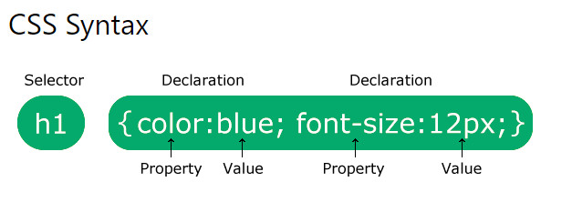
CSS Syntax
A CSS rule consists of a selector and a declaration block.
Notes:
Tip: The word cascading means that a style applied to a parent element will also apply to all children elements within the parent. So, if you set the color of the body text to "blue", all headings, paragraphs, and other text elements within the body will also get the same color (unless you specify something else)!

Slide 7
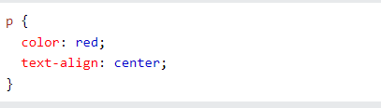
CSS Syntax …
The selector points to the HTML element you want to style.
The declaration block contains one or more declarations separated by semicolons.
Each declaration includes a CSS property name and a value, separated by a colon.
Multiple CSS declarations are separated with semicolons, and declaration blocks are surrounded by curly braces.

Slide 8
CSS Selectors
CSS selectors are used to "find" (or select) the HTML elements you want to style.
We can divide CSS selectors into five categories:
Simple selectors (select elements based on name, id, class)
Combinator selectors (select elements based on a specific relationship between them)
Pseudo-class selectors (select elements based on a certain state)
Pseudo-elements selectors (select and style a part of an element)
Attribute selectors (select elements based on an attribute or attribute value)

Slide 9
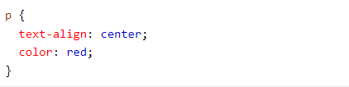
CSS Selectors - The CSS element Selector
The element selector selects HTML elements based on the element name.

Slide 10
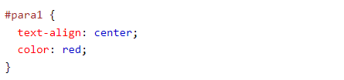
The CSS id Selector
The id selector uses the id attribute of an HTML element to select a specific element.
The id of an element is unique within a page, so the id selector is used to select one unique element!
To select an element with a specific id, write a hash (#) character, followed by the id of the element.
Notes:
An id name cannot start with a number!

Slide 11
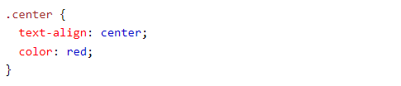
The CSS class Selector
The class selector selects HTML elements with a specific class attribute.
To select elements with a specific class, write a period (.) character, followed by the class name.

Slide 12
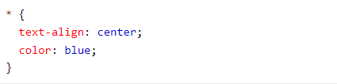
The CSS Universal Selector
The universal selector (*) selects all HTML elements on the page.

Slide 13
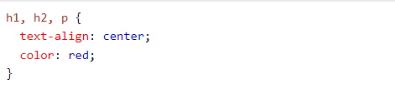
The CSS Grouping Selector
The grouping selector selects all the HTML elements with the same style definitions.
To group selectors, separate each selector with a comma.

Slide 14
USING CSS – HOW TO INCLUDE CSS INSIDE HTML
There are three ways of inserting a style sheet:
Inline CSS
Internal CSS
External CSS

Slide 15
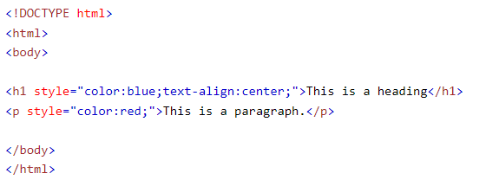
Inline CSS
An inline style may be used to apply a unique style for a single element.
To use inline styles, add the style attribute to the relevant element. The style attribute can contain any CSS property.

Slide 16
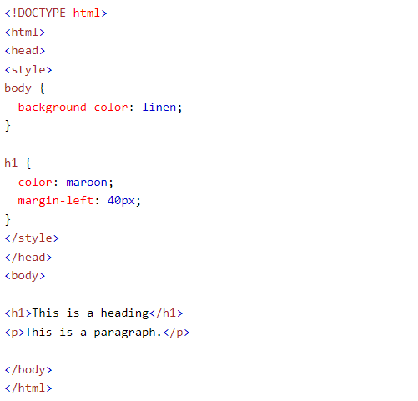
Internal CSS
An internal style sheet may be used if one single HTML page has a unique style.
The internal style is defined inside the <style> element, inside the head section.

Slide 17
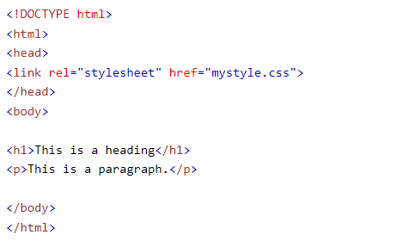
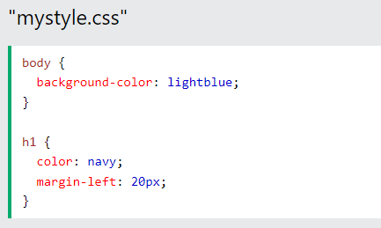
External CSS
With an external style sheet, you can change the look of an entire website by changing just one file!
Each HTML page must include a reference to the external style sheet file inside the <link> element, inside the head section.
An external style sheet can be written in any text editor, and must be saved with a .css extension.
Notes:
Note: Do not add a space between the property value (20) and the unit (px): Incorrect (space): margin-left: 20 px; Correct (no space): margin-left: 20px;

Slide 18
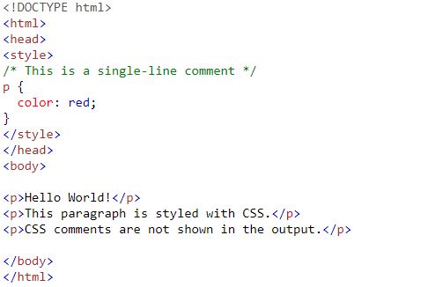
CSS Comments
Comments are used to explain the code, and may help when you edit the source code at a later date.
Comments are ignored by browsers.
A CSS comment is placed inside the <style> element, and starts with /* and ends with */:

Slide 19
CSS Colors
Colors are specified using predefined color names, or RGB, HEX, HSL, RGBA, HSLA values.
Check out the HTML Colors Section for detail explanation

Slide 20
CSS Backgrounds
The CSS background properties are used to add background effects for elements.
CSS Background has the following Properties
background-color
background-image
background-repeat
background-attachment
background-position
background (shorthand property)

Slide 21

CSS background-color
The background-color property specifies the background color of an element.
With CSS, a color is most often specified by:
a valid color name - like "red"
a HEX value - like "#ff0000"
an RGB value - like "rgb(255,0,0)"

Slide 22
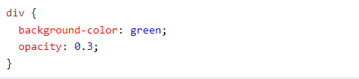
CSS Background Color – Opacity / Transparency
The opacity property specifies the opacity/transparency of an element.
It can take a value from 0.0 - 1.0. The lower value, the more transparent:
Notes:
Note: When using the opacity property to add transparency to the background of an element, all of its child elements inherit the same transparency. This can make the text inside a fully transparent element hard to read.

Slide 23

CSS background-image
The background-image property specifies an image to use as the background of an element.
By default, the image is repeated so it covers the entire element.
Notes:
Note: When using a background image, use an image that does not disturb the text.

Slide 24
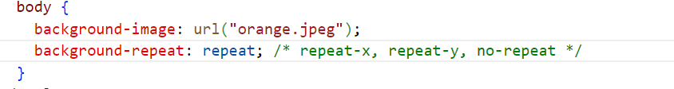
CSS background-repeat
By default, the background-image property repeats an image both horizontally and vertically.
Some images should be repeated only horizontally , vertically or not repeated
Background-repeat value
Background-repeat : repeat | Default value repeat vertically & horizontally
Background-repeat : repeat-x | Repeat horizontally
Background-repeat : repeat-y | Repeat vertically
Background-repeat : no-repeat | Did not repeat the background image

Slide 25
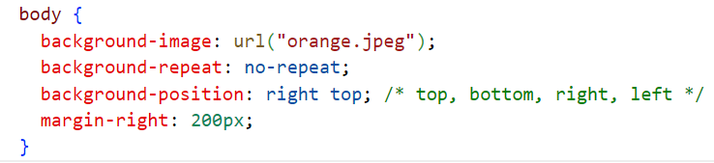
CSS background-position
The background-position property is used to specify the position of the background image.

Slide 26
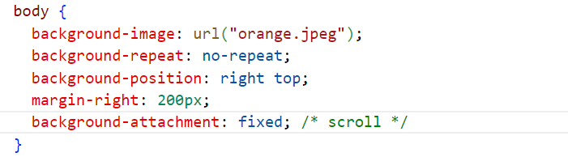
CSS Background Attachment
The background-attachment property specifies whether the background image should scroll or be fixed (will not scroll with the rest of the page):

Slide 27
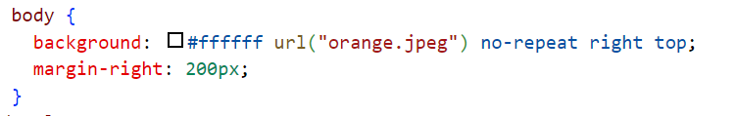
CSS Background Shorthand
To shorten the code, it is also possible to specify all the background properties in one single property. This is called a shorthand property.
When using the shorthand property the order of the property values is:
background-color
background-image
background-repeat
background-attachment
background-position
Notes:
It does not matter if one of the property values is missing, as long as the other ones are in this order. Note that we do not use the background-attachment property in the examples above, as it does not have a value.

Slide 28
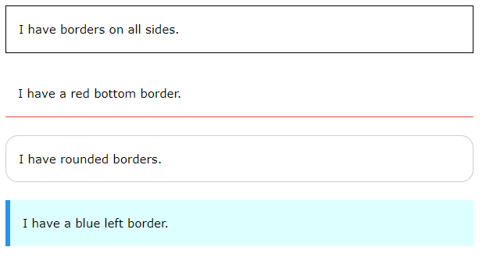
CSS Borders
The CSS border properties allow you to specify the style, width, and color of an element's border.

Slide 29
CSS Border Style
The border-style property specifies what kind of border to display.
dotted - Defines a dotted border
dashed - Defines a dashed border
solid - Defines a solid border
double - Defines a double border
groove - Defines a 3D grooved border. The effect depends on the border-color value
ridge - Defines a 3D ridged border. The effect depends on the border-color value
inset - Defines a 3D inset border. The effect depends on the border-color value
outset - Defines a 3D outset border. The effect depends on the border-color value
none - Defines no border
hidden - Defines a hidden border

Slide 30
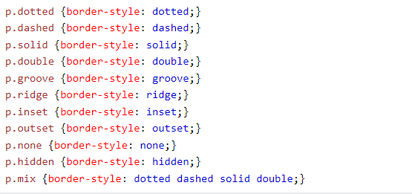
Border style …
Notes:
Note: None of the OTHER CSS border properties (which you will learn more about in the next chapters) will have ANY effect unless the border-style property is set!

Slide 31
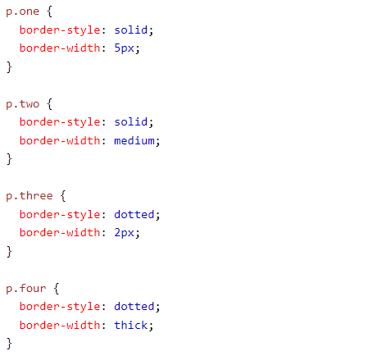
CSS Border Width
The border-width property specifies the width of the four borders.
The width can be set as a specific size (in px, pt, cm, em, etc) or by using one of the three pre-defined values: thin, medium, or thick:

Slide 32
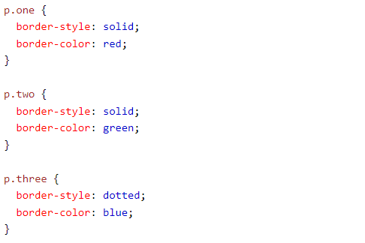
CSS Border Color
The border-color property is used to set the color of the four borders.
The color can be set by:
name - specify a color name, like "red"
HEX - specify a HEX value, like "#ff0000"
RGB - specify a RGB value, like "rgb(255,0,0)"
HSL - specify a HSL value, like "hsl(0, 100%, 50%)"

Slide 33
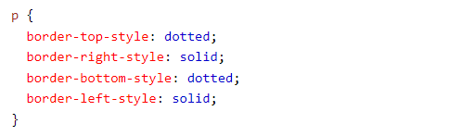
CSS Border - Individual Sides
In CSS, there are also properties for specifying each of the borders (top, right, bottom, and left):

Slide 34
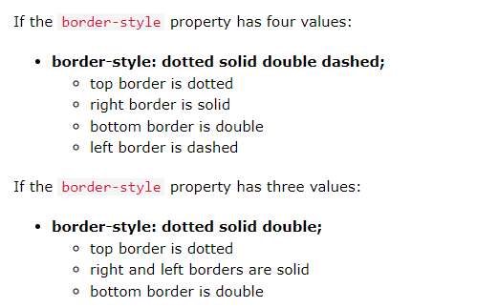
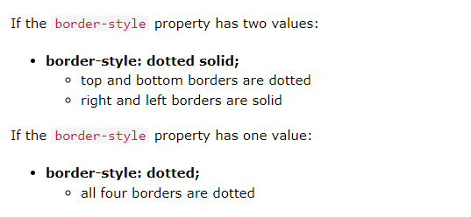
CSS Border - Individual Sides ….

Slide 35


CSS Shorthand Border Property
The border property is a shorthand property for the following individual border properties:
border-width
border-style (required)
border-color

Slide 36

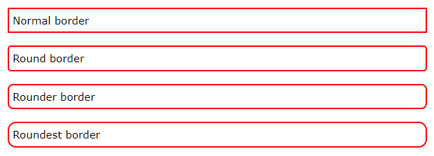
CSS Rounded Borders
The border-radius property is used to add rounded borders to an element:

Slide 37
CSS Margins
Margins are used to create space around elements, outside of any defined borders.
With CSS, you have full control over the margins. There are properties for setting the margin for each side of an element (top, right, bottom, and left).
The margin property is a shorthand property for the following individual margin properties:
margin-top
margin-right
margin-bottom
margin-left

Slide 38

Margin - Shorthand Property
If the margin property has four values:
margin: 25px 50px 75px 100px;
top margin is 25px
right margin is 50px
bottom margin is 75px
left margin is 100px

Slide 39
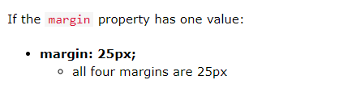
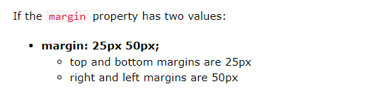
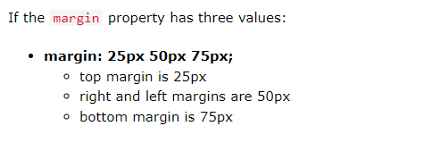
Margin shorthand ….

Slide 40
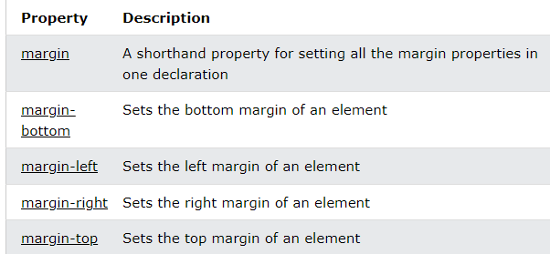
All CSS Margin Properties

Slide 41
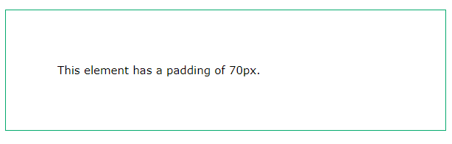
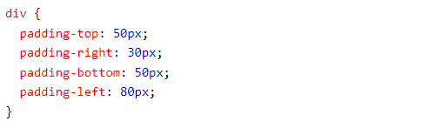
CSS Padding
Padding is used to create space around an element's content, inside of any defined borders.
CSS has properties for specifying the padding for each side of an element:
padding-top
padding-right
padding-bottom
padding-left

Slide 42
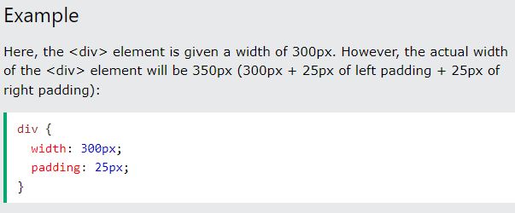
Padding and Element Width
The CSS width property specifies the width of the element's content area. The content area is the portion inside the padding, border, and margin of an element .
So, if an element has a specified width, the padding added to that element will be added to the total width of the element.

Slide 43
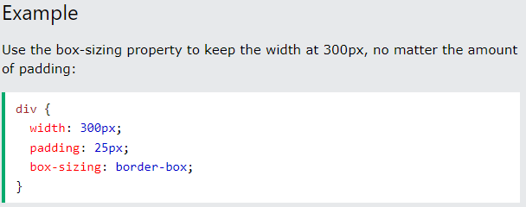
Padding and Element Width …
To keep the width at 300px, no matter the amount of padding, you can use the box-sizing property. This causes the element to maintain its actual width; if you increase the padding, the available content space will decrease.

Slide 44
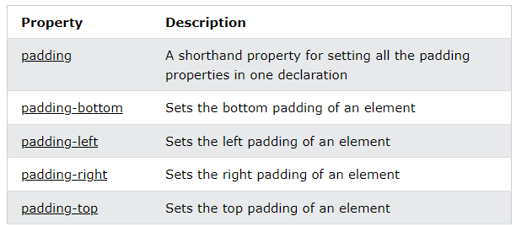
All CSS Padding Properties

Slide 45
CSS Height, Width and Max-width
The CSS height and width properties are used to set the height and width of an element.
The CSS max-width property is used to set the maximum width of an element.
The height and width properties are used to set the height and width of an element.
The height and width properties do not include padding, borders, or margins. It sets the height/width of the area inside the padding, border, and margin of the element.

Slide 46
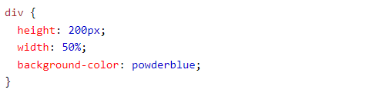
CSS height and width Values
The height and width properties may have the following values:
auto - This is default. The browser calculates the height and width
length - Defines the height/width in px, cm, etc.
% - Defines the height/width in percent of the containing block
initial - Sets the height/width to its default value
inherit - The height/width will be inherited from its parent value

Slide 47
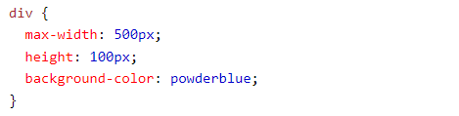
Setting max-width
The max-width property is used to set the maximum width of an element.
The max-width can be specified in length values, like px, cm, etc., or in percent (%) of the containing block, or set to none (this is default. Means that there is no maximum width).
Notes:
The problem with the <div> above occurs when the browser window is smaller than the width of the element (500px). The browser then adds a horizontal scrollbar to the page.
Using max-width instead, in this situation, will improve the browser's handling of small windows.
Tip: Drag the browser window to smaller than 500px wide, to see the difference between the two divs!

Slide 48
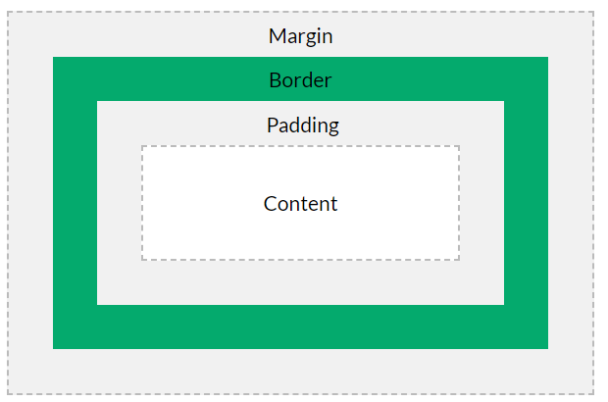
CSS Box Model
All HTML elements can be considered as boxes.
The CSS box model is essentially a box that wraps around every HTML element. It consists of: margins, borders, padding, and the actual content.
Explanation of the different parts:
Content - The content of the box, where text and images appear
Padding - Clears an area around the content. The padding is transparent
Border - A border that goes around the padding and content
Margin - Clears an area outside the border. The margin is transparent

Slide 49
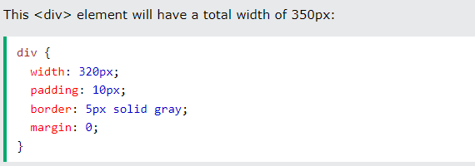
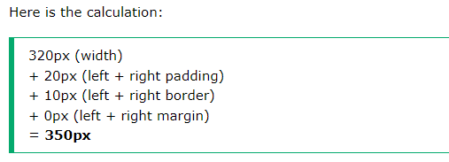
Width and Height of an Element
Notes:
he total width of an element should be calculated like this:
Total element width = width + left padding + right padding + left border + right border + left margin + right margin
The total height of an element should be calculated like this:
Total element height = height + top padding + bottom padding + top border + bottom border + top margin + bottom margin

Slide 50
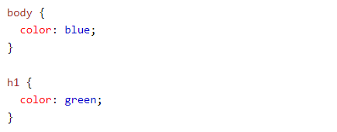
CSS Text - Text Color
CSS has a lot of properties for formatting text.
The color property is used to set the color of the text. The color is specified by:
a color name - like "red"
a HEX value - like "#ff0000"
an RGB value - like "rgb(255,0,0)“
The default text color for a page is defined in the body selector.
Notes:
Important: High contrast is very important for people with vision problems. So, always ensure that the contrast between the text color and the background color (or background image) is good!

Slide 51
CSS Text Alignment
Text alignment have the following properties
text-align
text-align-last
direction
unicode-bidi
vertical-align

Slide 52
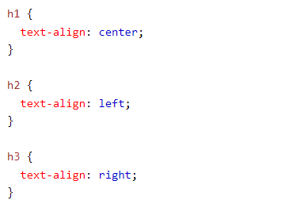
Text Alignment
The text-align property is used to set the horizontal alignment of a text.
A text can be left or right aligned, centered, or justified.
When the text-align property is set to "justify", each line is stretched so that every line has equal width, and the left and right margins are straight

Slide 53
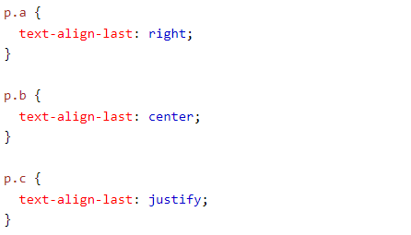
Text Align Last
The text-align-last property specifies how to align the last line of a text.

Slide 54
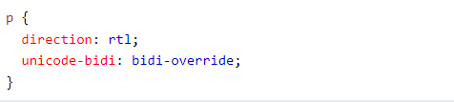
Text Direction
The direction and unicode-bidi properties can be used to change the text direction of an element:

Slide 55
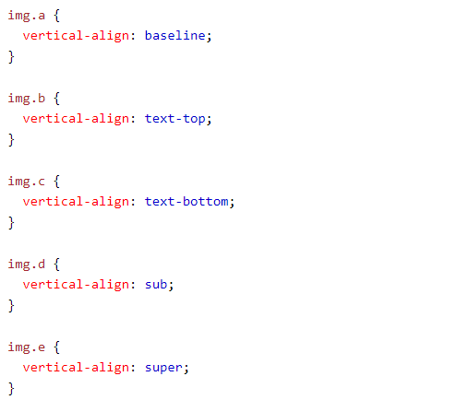
Vertical Alignment
The vertical-align property sets the vertical alignment of an element.

Slide 56
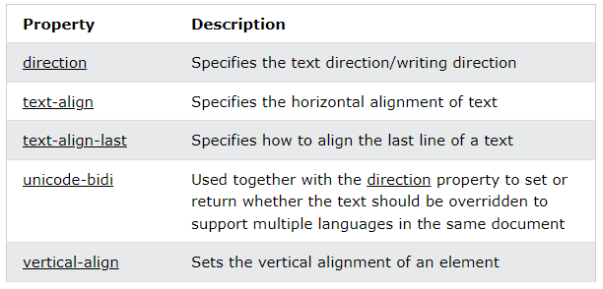
The CSS Text Alignment/Direction Properties

Slide 57
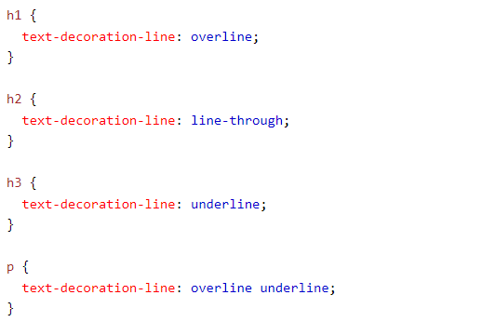
CSS Text Decoration
Text decoration have the following properties
text-decoration-line (required)
text-decoration-color (optional)
text-decoration-style (optional)
text-decoration-thickness (optional)
text-decoration
Notes:
Note: It is not recommended to underline text that is not a link, as this often confuses the reader.

Slide 58
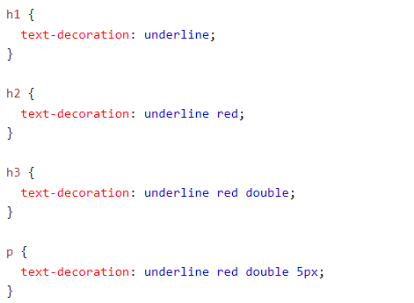
Text Decoration shorthand
The text-decoration property is a shorthand property for:
text-decoration-line (required)
text-decoration-color (optional)
text-decoration-style (optional)
text-decoration-thickness (optional)
Notes:
All links in HTML are underlined by default. Sometimes you see that links are styled with no underline. The text-decoration: none; is used to remove the underline from links, like this:

Slide 59
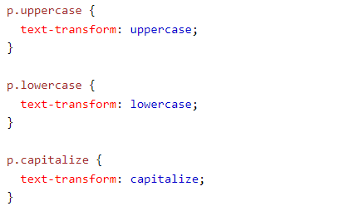
CSS Text Transformation
The text-transform property is used to specify uppercase and lowercase letters in a text.
It can be used to turn everything into uppercase or lowercase letters, or capitalize the first letter of each word:

Slide 60
CSS Text Spacing
The text-indent property is used to specify the indentation of the first line of a text:
The letter-spacing property is used to specify the space between the characters in a text.
The line-height property is used to specify the space between lines:
The word-spacing property is used to specify the space between the words in a text.
The white-space property specifies how white-space inside an element is handled.( nowrap, wrap)

Slide 61
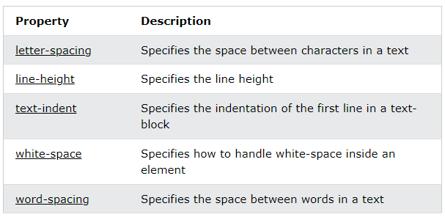
The CSS Text Spacing Properties

Slide 62

CSS Text Shadow
The text-shadow property adds shadow to text.
In its simplest use, you only specify the horizontal shadow (2px) , the vertical shadow (2px) , a blur effect (5px) and color (red)

Slide 63
CSS Fonts - Generic Font Families
In CSS there are five generic font families:
Serif fonts have a small stroke at the edges of each letter. They create a sense of formality and elegance.
Sans-serif fonts have clean lines (no small strokes attached). They create a modern and minimalistic look.
Monospace fonts - here all the letters have the same fixed width. They create a mechanical look.
Cursive fonts imitate human handwriting.
Fantasy fonts are decorative/playful fonts.
All the different font names belong to one of the generic font families.

Slide 64
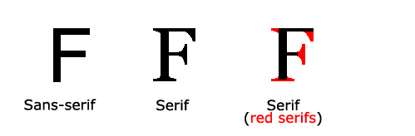
Difference Between Serif and Sans-serif Fonts

Slide 65

Some Font Examples

Slide 66

The CSS font-family Property
In CSS, we use the font-family property to specify the font of a text.
If the font name is more than one word, it must be in quotation marks, like: "Times New Roman".
Notes:
The font-family property should hold several font names as a "fallback" system, to ensure maximum compatibility between browsers/operating systems. Start with the font you want, and end with a generic family (to let the browser pick a similar font in the generic family, if no other fonts are available). The font names should be separated with comma.

Slide 67

CSS Font Style
The font-style property is mostly used to specify italic text.
This property has three values:
normal - The text is shown normally
italic - The text is shown in italics
oblique - The text is "leaning" (oblique is very similar to italic, but less supported)

Slide 68

Font Weight
The font-weight property specifies the weight of a font

Slide 69

Font Variant
The font-variant property specifies whether or not a text should be displayed in a small-caps font.
In a small-caps font, all lowercase letters are converted to uppercase letters. However, the converted uppercase letters appears in a smaller font size than the original uppercase letters in the text.

Slide 70
CSS Font Size
The font-size property sets the size of the text.
Being able to manage the text size is important in web design.
The font-size value can be an absolute, or relative size.
Absolute size:
Sets the text to a specified size
Does not allow a user to change the text size in all browsers (bad for accessibility reasons)
Absolute size is useful when the physical size of the output is known
Relative size:
Sets the size relative to surrounding elements
Allows a user to change the text size in browsers
Notes:
However, you should not use font size adjustments to make paragraphs look like headings, or headings look like paragraphs.
Note: If you do not specify a font size, the default size for normal text, like paragraphs, is 16px (16px=1em).

Slide 71

Set Font Size With Em
To allow users to resize the text (in the browser menu), many developers use em instead of pixels.
1em is equal to the current font size. The default text size in browsers is 16px. So, the default size of 1em is 16px.
The size can be calculated from pixels to em using this formula: pixels/16=em
Notes:
In the example above, the text size in em is the same as the previous example in pixels. However, with the em size, it is possible to adjust the text size in all browsers.
Unfortunately, there is still a problem with older versions of Internet Explorer. The text becomes larger than it should when made larger, and smaller than it should when made smaller.

Slide 72

Use a Combination of Percent and Em
The solution that works in all browsers, is to set a default font-size in percent for the <body> element:

Slide 73
Responsive Font Size
The text size can be set with a vw unit, which means the "viewport width".
That way the text size will follow the size of the browser window:
Viewport is the browser window size. 1vw = 1% of viewport width. If the viewport is 50cm wide, 1vw is 0.5cm.

Slide 74

The CSS Font Property
To shorten the code, it is also possible to specify all the individual font properties in one property.
The font property is a shorthand property for:
font-style
font-variant
font-weight
font-size/line-height
font-family
Note: The font-size and font-family values are required. If one of the other values is missing, their default value are used.

Slide 76

CSS Links
With CSS, links can be styled in many different ways.
Links can be styled with any CSS property (e.g. color, font-family, background, etc.).

Slide 77

CSS Links ….
In addition, links can be styled differently depending on what state they are in.
The four links states are:
a:link - a normal, unvisited link
a:visited - a link the user has visited
a:hover - a link when the user mouses over it
a:active - a link the moment it is clicked
Notes:
When setting the style for several link states, there are some order rules:
a:hover MUST come after a:link and a:visited
a:active MUST come after a:hover

Slide 78

CSS Links – Text Decoration
The text-decoration property is mostly used to remove underlines from links:

Slide 79

CSS Lists

Slide 80
HTML Lists and CSS List Properties
In HTML, there are two main types of lists:
unordered lists (<ul>) - the list items are marked with bullets
ordered lists (<ol>) - the list items are marked with numbers or letters
The CSS list properties allow you to:
Set different list item markers for ordered lists
Set different list item markers for unordered lists
Set an image as the list item marker
Add background colors to lists and list items

Slide 81

Different List Item Markers - list-style-type
The list-style-type property specifies the type of list item marker.
The following example shows some of the available list item markers:

Slide 82

Different List Item Markers - list-style-image
The list-style-image property specifies an image as the list item marker:

Slide 83



Different List Item Markers - list-style-position
The list-style-position property specifies the position of the list-item markers (bullet points).
"list-style-position: outside;" means that the bullet points will be outside the list item. The start of each line of a list item will be aligned vertically. This is default:
"list-style-position: inside;" means that the bullet points will be inside the list item. As it is part of the list item, it will be part of the text and push the text at the start:

Slide 84

CSS Lists - Remove Default Settings
The list-style-type:none property can also be used to remove the markers/bullets. Note that the list also has default margin and padding. To remove this, add margin:0 and padding:0 to <ul> or <ol>:

Slide 85
List - Shorthand property
The list-style property is a shorthand property. It is used to set all the list properties in one declaration:
When using the shorthand property, the order of the property values are:
list-style-type (if a list-style-image is specified, the value of this property will be displayed if the image for some reason cannot be displayed)
list-style-position (specifies whether the list-item markers should appear inside or outside the content flow)
list-style-image (specifies an image as the list item marker)

Slide 86

CSS Tables - Table Borders
To specify table borders in CSS, use the border property.
The example below specifies a solid border for <table>, <th>, and <td> elements:

Slide 87

CSS Tables - Full-Width Table
The table above might seem small in some cases. If you need a table that should span the entire screen (full-width), add width: 100% to the <table> element:

Slide 88

CSS Tables - Collapse Table Borders
The border-collapse property sets whether the table borders should be collapsed into a single border:

Slide 89

Table Width and Height
The width and height of a table are defined by the width and height properties.
The example below sets the width of the table to 100%, and the height of the <th> elements to 70px:

Slide 90

CSS Table Alignment
The text-align property sets the horizontal alignment (like left, right, or center) of the content in <th> or <td>.
By default, the content of <th> elements are center-aligned and the content of <td> elements are left-aligned.
To center-align the content of <td> elements as well, use text-align: center:

Slide 91

Vertical Alignment
The vertical-align property sets the vertical alignment (like top, bottom, or middle) of the content in <th> or <td>.
By default, the vertical alignment of the content in a table is middle (for both <th> and <td> elements).
The following example sets the vertical text alignment to bottom for <td> elements:

Slide 92
CSS Layout - The display Property
The display property is the most important CSS property for controlling layout.
The display property specifies if/how an element is displayed.
Every HTML element has a default display value depending on what type of element it is. The default display value for most elements is block or inline.

Slide 93
Block-level Elements
A block-level element always starts on a new line and takes up the full width available (stretches out to the left and right as far as it can).
Examples of block-level elements:
<div>
<h1> - <h6>
<p>
<form>
<header>
<footer>
<section>

Slide 94
Inline Elements
An inline element does not start on a new line and only takes up as much width as necessary.
Examples of inline elements:
<span>
<a>
<img>

Slide 95
Display: none;
display: none; is commonly used with JavaScript to hide and show elements without deleting and recreating them. Take a look at our last example on this page if you want to know how this can be achieved.
The <script> element uses display: none; as default.

Slide 96

Override The Default Display Value
every element has a default display value. However, you can override this.
Changing an inline element to a block element, or vice versa, can be useful for making the page look a specific way, and still follow the web standards.
A common example is making inline <li> elements for horizontal menus:
Notes:
Note: Setting the display property of an element only changes how the element is displayed, NOT what kind of element it is. So, an inline element with display: block; is not allowed to have other block elements inside it.

Slide 97

Display …
The following example displays <span> elements as block elements:

Slide 98

Hide an Element - display:none or visibility:hidden?
Hiding an element can be done by setting the display property to none. The element will be hidden, and the page will be displayed as if the element is not there:

Slide 99

Hide an Element - display:none or visibility:hidden?
visibility:hidden; also hides an element.
However, the element will still take up the same space as before. The element will be hidden, but still affect the layout:

Slide 100
CSS Layout - The position Property
The position property specifies the type of positioning method used for an element (static, relative, fixed, absolute or sticky).
The position property specifies the type of positioning method used for an element.
There are five different position values:
static
relative
fixed
absolute
Sticky
Elements are then positioned using the top, bottom, left, and right properties.
Notes:
Elements are then positioned using the top, bottom, left, and right properties. However, these properties will not work unless the position property is set first. They also work differently depending on the position value.

Slide 101

position: static;
HTML elements are positioned static by default.
Static positioned elements are not affected by the top, bottom, left, and right properties.
An element with position: static; is not positioned in any special way; it is always positioned according to the normal flow of the page:

Slide 102

position: relative;
An element with position: relative; is positioned relative to its normal position.
Setting the top, right, bottom, and left properties of a relatively-positioned element will cause it to be adjusted away from its normal position. Other content will not be adjusted to fit into any gap left by the element.

Slide 103

position: fixed;
An element with position: fixed; is positioned relative to the viewport, which means it always stays in the same place even if the page is scrolled. The top, right, bottom, and left properties are used to position the element.
A fixed element does not leave a gap in the page where it would normally have been located.

Slide 104

position: absolute;
An element with position: absolute; is positioned relative to the nearest positioned ancestor (instead of positioned relative to the viewport, like fixed).
However; if an absolute positioned element has no positioned ancestors, it uses the document body, and moves along with page scrolling.
Note: Absolute positioned elements are removed from the normal flow, and can overlap elements.

Slide 105

position: sticky;
An element with position: sticky; is positioned based on the user's scroll position.
A sticky element toggles between relative and fixed, depending on the scroll position. It is positioned relative until a given offset position is met in the viewport - then it "sticks" in place (like position:fixed).
In this example, the sticky element sticks to the top of the page (top: 0), when you reach its scroll position.
Notes:
Note: Internet Explorer does not support sticky positioning. Safari requires a -webkit- prefix (see example below). You must also specify at least one of top, right, bottom or left for sticky positioning to work.

Slide 106

CSS Layout - The z-index Property
The z-index property specifies the stack order of an element.
When elements are positioned, they can overlap other elements.
The z-index property specifies the stack order of an element (which element should be placed in front of, or behind, the others).
An element can have a positive or negative stack order:
Notes:
Note: z-index only works on positioned elements (position: absolute, position: relative, position: fixed, or position: sticky) and flex items (elements that are direct children of display: flex elements).

Slide 107
Without z-index
If two positioned elements overlap each other without a z-index specified, the element defined last in the HTML code will be shown on top.

Slide 108
CSS Layout - Overflow
The CSS overflow property controls what happens to content that is too big to fit into an area.
The overflow property specifies whether to clip the content or to add scrollbars when the content of an element is too big to fit in the specified area.
The overflow property has the following values:
visible - Default. The overflow is not clipped. The content renders outside the element's box
hidden - The overflow is clipped, and the rest of the content will be invisible
scroll - The overflow is clipped, and a scrollbar is added to see the rest of the content
auto - Similar to scroll, but it adds scrollbars only when necessary
Notes:
Note: The overflow property only works for block elements with a specified height.

Slide 109

overflow: visible
By default, the overflow is visible, meaning that it is not clipped and it renders outside the element's box:

Slide 110

overflow: hidden
With the hidden value, the overflow is clipped, and the rest of the content is hidden:

Slide 111

overflow: scroll
Setting the value to scroll, the overflow is clipped and a scrollbar is added to scroll inside the box. Note that this will add a scrollbar both horizontally and vertically (even if you do not need it):

Slide 112

overflow: auto
The auto value is similar to scroll, but it adds scrollbars only when necessary:

Slide 113

overflow-x and overflow-y
The overflow-x and overflow-y properties specifies whether to change the overflow of content just horizontally or vertically (or both):
overflow-x specifies what to do with the left/right edges of the content.
overflow-y specifies what to do with the top/bottom edges of the content

Slide 114

All CSS Overflow Properties

Slide 115


CSS overflow-wrap Property
The overflow-wrap property specifies whether or not the browser can break lines with long words, if they overflow the container.

Slide 116
CSS Layout - float and clear
The CSS float property specifies how an element should float.
The clear property specifies what should happen with the element that is next to a floating element.
The float property is used for positioning and formatting content e.g. let an image float left to the text in a container.
The float property can have one of the following values:
left - The element floats to the left of its container
right - The element floats to the right of its container
none - The element does not float (will be displayed just where it occurs in the text). This is default
inherit - The element inherits the float value of its parent
Notes:
In its simplest use, the float property can be used to wrap text around images.

Slide 117


float: right;

Slide 118


float: left;

Slide 119


No float
In the following example the image will be displayed just where it occurs in the text (float: none;):

Slide 120

CSS Layout - clear and clearfix
The clear property specifies what should happen with the element that is next to a floating element.
The clear property can have one of the following values:
none - The element is not pushed below left or right floated elements. This is default
left - The element is pushed below left floated elements
right - The element is pushed below right floated elements
both - The element is pushed below both left and right floated elements
inherit - The element inherits the clear value from its parent
Notes:
When clearing floats, you should match the clear to the float: If an element is floated to the left, then you should clear to the left. Your floated element will continue to float, but the cleared element will appear below it on the web page.

Slide 121


The clearfix Hack
If a floated element is taller than the containing element, it will "overflow" outside of its container. We can then add a clearfix hack to solve this problem:
Notes:
The overflow: auto clearfix works well as long as you are able to keep control of your margins and padding (else you might see scrollbars). The new, modern clearfix hack however, is safer to use, and the following code is used for most webpages:

Slide 122

new, modern clearfix hack

Slide 123
CSS Layout - display: inline-block
Compared to display: inline, the major difference is that display: inline-block allows to set a width and height on the element.
Also, with display: inline-block, the top and bottom margins/paddings are respected, but with display: inline they are not.
Compared to display: block, the major difference is that display: inline-block does not add a line-break after the element, so the element can sit next to other elements.

Slide 124
CSS Combinators
A combinator is something that explains the relationship between the selectors.
A CSS selector can contain more than one simple selector. Between the simple selectors, we can include a combinator.
There are four different combinators in CSS:
descendant selector (space)
child selector (>)
adjacent sibling selector (+)
general sibling selector (~)

Slide 125

Descendant Selector
The descendant selector matches all elements that are descendants of a specified element.
The following example selects all <p> elements inside <div> elements:

Slide 126

Child Selector (>)
The child selector selects all elements that are the children of a specified element.
The following example selects all <p> elements that are children of a <div> element:

Slide 127

Adjacent Sibling Selector (+)
The adjacent sibling selector is used to select an element that is directly after another specific element.
Sibling elements must have the same parent element, and "adjacent" means "immediately following".

Slide 128

General Sibling Selector (~)
The general sibling selector selects all elements that are next siblings of a specified element.
The following example selects all <p> elements that are next siblings of <div> elements:

Slide 129

CSS Pseudo-classes
A pseudo-class is used to define a special state of an element.
For example, it can be used to:
Style an element when a user mouses over it
Style visited and unvisited links differently
Style an element when it gets focus

Slide 130

Anchor Pseudo-classes

Slide 131


Pseudo-classes and HTML Classes
Pseudo-classes can be combined with HTML classes:
When you hover over the link in the example, it will change color:

Slide 132

The :first-child Pseudo-class
The :first-child pseudo-class matches a specified element that is the first child of another element.
Match the first <p> element
In the following example, the selector matches any <p> element that is the first child of any element:

Slide 133



Slide 134

CSS Pseudo-elements
A CSS pseudo-element is used to style specified parts of an element.
For example, it can be used to:
Style the first letter, or line, of an element
Insert content before, or after, the content of an element

Slide 135

The ::first-line Pseudo-element
The ::first-line pseudo-element is used to add a special style to the first line of a text.
The following example formats the first line of the text in all <p> elements:
Notes:
Note: The ::first-line pseudo-element can only be applied to block-level elements.

Slide 136

The ::first-letter Pseudo-element
The ::first-letter pseudo-element is used to add a special style to the first letter of a text.
The following example formats the first letter of the text in all <p> elements:
Notes:
Note: The ::first-letter pseudo-element can only be applied to block-level elements.

Slide 137

CSS - The ::before Pseudo-element
The ::before pseudo-element can be used to insert some content before the content of an element.
The following example inserts an image before the content of each <h1> element:

Slide 138

CSS - The ::after Pseudo-element
The ::after pseudo-element can be used to insert some content after the content of an element.
The following example inserts an image after the content of each <h1> element:

Slide 139

CSS - The ::marker Pseudo-element
The ::marker pseudo-element selects the markers of list items.
The following example styles the markers of list items:

Slide 140

CSS - The ::selection Pseudo-element
The ::selection pseudo-element matches the portion of an element that is selected by a user.
The following CSS properties can be applied to ::selection: color, background, cursor, and outline.

Slide 141

All CSS Pseudo Elements

Slide 145

CSS Attribute Selectors
It is possible to style HTML elements that have specific attributes or attribute values.
The [attribute] selector is used to select elements with a specified attribute.
The following example selects all <a> elements with a target attribute:

Slide 146

CSS [attribute="value"] Selector
The [attribute="value"] selector is used to select elements with a specified attribute and value.
The following example selects all <a> elements with a target="_blank" attribute:

Slide 147

CSS [attribute~="value"] Selector
The [attribute~="value"] selector is used to select elements with an attribute value containing a specified word.
The following example selects all elements with a title attribute that contains a space-separated list of words, one of which is "flower":
Notes:
The example above will match elements with title="flower", title="summer flower", and title="flower new", but not title="my-flower" or title="flowers".

Slide 148

CSS [attribute|="value"] Selector
The [attribute|="value"] selector is used to select elements with the specified attribute, whose value can be exactly the specified value, or the specified value followed by a hyphen (-).
Note: The value has to be a whole word, either alone, like class="top", or followed by a hyphen( - ), like class="top-text".

Slide 149

CSS [attribute^="value"] Selector
The [attribute^="value"] selector is used to select elements with the specified attribute, whose value starts with the specified value.
The following example selects all elements with a class attribute value that starts with "top":
Note: The value does not have to be a whole word!

Slide 150

CSS [attribute$="value"] Selector
The [attribute$="value"] selector is used to select elements whose attribute value ends with a specified value.
The following example selects all elements with a class attribute value that ends with "test":
Note: The value does not have to be a whole word!

Slide 151

CSS [attribute*="value"] Selector
The [attribute*="value"] selector is used to select elements whose attribute value contains a specified value.
The following example selects all elements with a class attribute value that contains "te":
Note: The value does not have to be a whole word!

Slide 152

CSS Units
CSS has several different units for expressing a length.
Many CSS properties take "length" values, such as width, margin, padding, font-size, etc.
Length is a number followed by a length unit, such as 10px, 2em, etc.
Notes:
Note: A whitespace cannot appear between the number and the unit. However, if the value is 0, the unit can be omitted.
For some CSS properties, negative lengths are allowed.

Slide 153

CSS Units - Absolute Lengths
The absolute length units are fixed and a length expressed in any of these will appear as exactly that size.
Absolute length units are not recommended for use on screen, because screen sizes vary so much. However, they can be used if the output medium is known, such as for print layout.
Notes:
* Pixels (px) are relative to the viewing device. For low-dpi devices, 1px is one device pixel (dot) of the display. For printers and high resolution screens 1px implies multiple device pixels.

Slide 154

CSS Units - Absolute Lengths
Relative length units specify a length relative to another length property. Relative length units scale better between different rendering mediums.
Notes:
Tip: The em and rem units are practical in creating perfectly scalable layout!
* Viewport = the browser window size. If the viewport is 50cm wide, 1vw = 0.5cm.

Slide 155

CSS Specificity
If there are two or more CSS rules that point to the same element, the selector with the highest specificity value will "win", and its style declaration will be applied to that HTML element.
Think of specificity as a score/rank that determines which style declaration is ultimately applied to an element.

Slide 156

CSS Specificity

Slide 157

CSS Specificity

Slide 158
Specificity Hierarchy
Every CSS selector has its place in the specificity hierarchy.
There are four categories which define the specificity level of a selector:
Inline styles - Example: <h1 style="color: pink;">
IDs - Example: #navbar
Classes, pseudo-classes, attribute selectors - Example: .test, :hover, [href]
Elements and pseudo-elements - Example: h1, ::before

Slide 159

CSS The !important Rule
The !important rule in CSS is used to add more importance to a property/value than normal.
In fact, if you use the !important rule, it will override ALL previous styling rules for that specific property on that element!

Slide 160

Important About !important
The only way to override an !important rule is to include another !important rule on a declaration with the same (or higher) specificity in the source code - and here the problem starts!
This makes the CSS code confusing and the debugging will be hard, especially if you have a large style sheet!

Slide 161

CSS Math Functions
The CSS math functions allow mathematical expressions to be used as property values. Here, we will explain the calc(), max() and min() functions.
The calc() Function
The calc() function performs a calculation to be used as the property value.

Slide 162

The calc() Function

Slide 163


The max() Function
The max() function uses the largest value, from a comma-separated list of values, as the property value.

Slide 164


The min() Function
The min() function uses the smallest value, from a comma-separated list of values, as the property value.

Slide 165
CSS Rounded Corners
With the CSS border-radius property, you can give any element "rounded corners".
The CSS border-radius property defines the radius of an element's corners.
Tip: The border-radius property is actually a shorthand property for the
border-top-left-radius,
border-top-right-radius,
border-bottom-right-radius and
border-bottom-left-radius

Slide 166

CSS Rounded Corners Properties

Slide 167
CSS Gradients
CSS gradients let you display smooth transitions between two or more specified colors.
Linear Gradients (goes down/up/left/right/diagonally)
Radial Gradients (defined by their center)
Conic Gradients (rotated around a center point)

Slide 168

CSS Linear Gradients
To create a linear gradient you must define at least two color stops.
Color stops are the colors you want to render smooth transitions among.
You can also set a starting point and a direction (or an angle) along with the gradient effect.

Slide 169

Direction - Top to Bottom (this is default)
The following example shows a linear gradient that starts at the top. It starts red, transitioning to yellow

Slide 170


Direction - Left to Right
The following example shows a linear gradient that starts from the left. It starts red, transitioning to yellow:

Slide 171

Direction - Diagonal
You can make a gradient diagonally by specifying both the horizontal and vertical starting positions.
The following example shows a linear gradient that starts at top left (and goes to bottom right). It starts red, transitioning to yellow:

Slide 172

CSS Radial Gradients
A radial gradient is defined by its center.
To create a radial gradient you must also define at least two color stops.
By default, shape is ellipse, size is farthest-corner, and position is center.

Slide 173


Radial Gradient - Evenly Spaced Color Stops (this is default)
The following example shows a radial gradient with evenly spaced color stops:

Slide 174

Radial Gradient - Differently Spaced Color Stops

Slide 175


Set Shape
The shape parameter defines the shape. It can take the value circle or ellipse. The default value is ellipse.
The following example shows a radial gradient with the shape of a circle:

Slide 176


Repeating a radial-gradient
The repeating-radial-gradient() function is used to repeat radial gradients:

Slide 177

Use of Different Size Keywords
The size parameter defines the size of the gradient. It can take four values:
closest-side
farthest-side
closest-corner
farthest-corner

Slide 178

CSS Shadow Effects
With CSS you can add shadow to text and to elements.
There are two types of shadow effects
text-shadow
box-shadow
The CSS text-shadow property applies shadow to text.
In its simplest use, you only specify the horizontal shadow (2px), the vertical shadow (2px) and blur effect(5px) with color.

Slide 179

Multiple Shadows
To add more than one shadow to the text, you can add a comma-separated list of shadows.
The following example shows a red and blue neon glow shadow:

Slide 180

CSS Box Shadow
The CSS box-shadow property is used to apply one or more shadows to an element.

Slide 181

Add a Blur Effect to the Shadow
The blur parameter defines the blur radius. The higher the number, the more blurred the shadow will be.

Slide 182


CSS Text Overflow
The CSS text-overflow property specifies how overflowed content that is not displayed should be signaled to the user.

Slide 183


CSS Word Wrapping
The CSS word-wrap property allows long words to be able to be broken and wrap onto the next line.
If a word is too long to fit within an area, it expands outside:

Slide 184


CSS Word Breaking
The CSS word-break property specifies line breaking rules.

Slide 185

CSS Writing Mode
The CSS writing-mode property specifies whether lines of text are laid out horizontally or vertically.
Some text with a span element with a vertical-rl writing-mode.

Slide 186
CSS Transitions
CSS transitions allows you to change property values smoothly, over a given duration.
CSS transition have the following properties
transition
transition-delay
transition-duration
transition-property
transition-timing-function
To create a transition effect, you must specify two things:
the CSS property you want to add an effect to
the duration of the effect

Slide 187


CSS Transition
The following example shows a 100px * 100px red <div> element. The <div> element has also specified a transition effect for the width property, with a duration of 2 seconds:
The transition effect will start when the specified CSS property (width) changes value.
Notes:
Notice that when the cursor mouses out of the element, it will gradually change back to its original style.

Slide 188

Change Several Property Values
The following example adds a transition effect for both the width and height property, with a duration of 2 seconds for the width and 4 seconds for the height

Slide 189
Specify the Speed Curve of the Transition
The transition-timing-function property specifies the speed curve of the transition effect.
The transition-timing-function property can have the following values:
ease - specifies a transition effect with a slow start, then fast, then end slowly (this is default)
linear - specifies a transition effect with the same speed from start to end
ease-in - specifies a transition effect with a slow start
ease-out - specifies a transition effect with a slow end
ease-in-out - specifies a transition effect with a slow start and end
cubic-bezier(n,n,n,n) - lets you define your own values in a cubic-bezier function

Slide 190


Transition short hand property

Slide 191
CSS The object-fit Property
The CSS object-fit property is used to specify how an <img> or <video> should be resized to fit its container.
This property tells the content to fill the container in a variety of ways; such as "preserve that aspect ratio" or "stretch up and take up as much space as possible".
Here is where the object-fit property comes in. The object-fit property can take one of the following values:
fill - This is default. The image is resized to fill the given dimension. If necessary, the image will be stretched or squished to fit
contain - The image keeps its aspect ratio, but is resized to fit within the given dimension
cover - The image keeps its aspect ratio and fills the given dimension. The image will be clipped to fit
none - The image is not resized
scale-down - the image is scaled down to the smallest version of none or contain

Slide 192

Using object-fit: cover
If we use object-fit: cover; the image keeps its aspect ratio and fills the given dimension. The image will be clipped to fit:

Slide 193

Using object-fit: contain;
If we use object-fit: contain; the image keeps its aspect ratio, but is resized to fit within the given dimension:

Slide 194

Using object-fit: fill;
If we use object-fit: fill; the image is resized to fill the given dimension. If necessary, the image will be stretched or squished to fit:

Slide 195

Using object-fit: none;
If we use object-fit: none; the image is not resized:

Slide 196

Using object-fit: scale-down;
If we use object-fit: scale-down; the image is scaled down to the smallest version of none or contain:

Slide 197

CSS The object-position Property
To position the image, we will use the object-position property.
Here we will use the object-position property to position the image so that the great old building is in center:

Slide 198

CSS Variables - The var() Function
The var() function is used to insert the value of a CSS variable.
CSS variables have access to the DOM, which means that you can create variables with local or global scope, change the variables with JavaScript, and change the variables based on media queries.
Syntax of the var() Function
The var() function is used to insert the value of a CSS variable.
The syntax of the var() function is as follows:
Notes:
Note: The variable name must begin with two dashes (--) and it is case sensitive!

Slide 199

How var() Works
CSS variables can have a global or local scope.
Global variables can be accessed/used through the entire document, while local variables can be used only inside the selector where it is declared.
To create a variable with global scope, declare it inside the :root selector. The :root selector matches the document's root element.
To create a variable with local scope, declare it inside the selector that is going to use it.
Notes:
Advantages of using var() are:
makes the code easier to read (more understandable)
makes it much easier to change the color values

Slide 200
CSS Media Queries
CSS2 Introduced Media Types
The @media rule, introduced in CSS2, made it possible to define different style rules for different media types.
Examples: You could have one set of style rules for computer screens, one for printers, one for handheld devices, one for television-type devices, and so on.
Unfortunately these media types never got a lot of support by devices, other than the print media type.

Slide 201
CSS Media Queries - CSS3 Introduced Media Queries
Media queries in CSS3 extended the CSS2 media types idea: Instead of looking for a type of device, they look at the capability of the device.
Media queries can be used to check many things, such as:
width and height of the viewport
width and height of the device
orientation (is the tablet/phone in landscape or portrait mode?)
Resolution
Using media queries are a popular technique for delivering a tailored style sheet to desktops, laptops, tablets, and mobile phones

Slide 202

Media Query Syntax
A media query consists of a media type and can contain one or more expressions, which resolve to either true or false.
The result of the query is true if the specified media type matches the type of device the document is being displayed on and all expressions in the media query are true.
When a media query is true, the corresponding style sheet or style rules are applied, following the normal cascading rules.

Slide 203


CSS3 Media Types
Unless you use the not or only operators, the media type is optional and the all type will be implied.
Notes:
The following example changes the background-color to lightgreen if the viewport is 480 pixels wide or wider (if the viewport is less than 480 pixels, the background-color will be pink):

Slide 204
CSS Flexbox Layout Module
Before the Flexbox Layout module, there were four layout modes:
Block, for sections in a webpage
Inline, for text
Table, for two-dimensional table data
Positioned, for explicit position of an element
The Flexible Box Layout Module, makes it easier to design flexible responsive layout structure without using float or positioning.

Slide 205


Flexbox Elements
To start using the Flexbox model, you need to first define a flex container.
The element above represents a flex container (the blue area) with three flex items.

Slide 206


CSS Flex Container
The flex container becomes flexible by setting the display property to flex:

Slide 207
flex container properties
The flex container properties are:
flex-direction
flex-wrap
flex-flow
justify-content
align-items
align-content

Slide 208
Parent Element (Container)
The flex container becomes flexible by setting the display property to flex:
The flex container properties are:
Property Name | Possible Values
Flex-direction | Row, column, row-reverse, column-reverse
Flex-wrap | Wrap, nowrap, wrap-reverse
Flex-flow | Flex-direction flex-wrap
Justify-content | Center, flex-start, flex-end, space-around, space-between,
Align-items | Center, flex-start, flex-end, stretch, baseline
Align-content | Center, stretch, space-around, space-between, flex-start, flex-end
Notes:
The justify-content property is used to align the flex items.
The align-items property is used to align the flex items vertically.
The baseline value aligns the flex items such as their text-baselines aligns
The align-content property is used to align the flex lines.

Slide 209


The flex-direction Property
The flex-direction property defines in which direction the container wants to stack the flex items.

Slide 210


The flex item properties
Flex item Property | Posible Values
Order | value
Flex-grow | value
Flex-shrink | Value
Flex-basis | Value in units
Flex | Flex-grow flex-shrink, flex-basis
Align-self | Center, flex-end, flex-start
Notes:
The flex-shrink property specifies how much a flex item will shrink relative to the rest of the flex items. The value must be a number, default value is 1.
The flex-basis property specifies the initial length of a flex item.

Slide 211

CSS Grid Layout Module
The CSS Grid Layout Module offers a grid-based layout system, with rows and columns, making it easier to design web pages without having to use floats and positioning.

Slide 212


Grid Elements
A grid layout consists of a parent element, with one or more child elements.

Slide 213


Display Property
An HTML element becomes a grid container when its display property is set to grid or inline-grid.
Notes:
All direct children of the grid container automatically become grid items.

Slide 214

Grid Columns
The vertical lines of grid items are called columns.

Slide 215

Grid Rows
The horizontal lines of grid items are called rows.

Slide 216



Grid Gaps
The spaces between each column/row are called gaps.
You can adjust the gap size by using one of the following properties:
column-gap
row-gap
gap
Notes:
The gap property is a shorthand property for the row-gap and the column-gap properties:
The gap property can also be used to set both the row gap and the column gap in one value:

Slide 217

Grid Lines
The lines between columns are called column lines.
The lines between rows are called row lines.
Notes:
Refer to line numbers when placing a grid item in a grid container:

Slide 218


Place a grid item at column line 1, and let it end on column line 3:

Slide 219

The grid-template-columns Property
The grid-template-columns property defines the number of columns in your grid layout, and it can define the width of each column.
The value is a space-separated-list, where each value defines the width of the respective column.
If you want your grid layout to contain 4 columns, specify the width of the 4 columns, or "auto" if all columns should have the same width.
Notes:
Note: If you have more than 4 items in a 4 columns grid, the grid will automatically add a new row to put the items in.

Slide 220

The grid-template-columns Property …
The grid-template-columns property can also be used to specify the size (width) of the columns.

Slide 221

The grid-template-rows Property
The grid-template-rows property defines the height of each row.
The value is a space-separated-list, where each value defines the height of the respective row:

Slide 222

The value is a space-separated-list, where each value defines the height of the respective row:

Slide 223

The justify-content Property
The justify-content property is used to align the whole grid inside the container.
Notes:
Note: The grid's total width has to be less than the container's width for the justify-content property to have any effect.

Slide 224

The align-content Property
The align-content property is used to vertically align the whole grid inside the container.
Notes:
Note: The grid's total height has to be less than the container's height for the align-content property to have any effect.

Slide 225

CSS Grid Item
A grid container contains grid items.
By default, a container has one grid item for each column, in each row, but you can style the grid items so that they will span multiple columns and/or rows.

Slide 226

The grid-column Property:
The grid-column property defines on which column(s) to place an item.
You define where the item will start, and where the item will end.
The grid-column property is a shorthand property for the grid-column-start and the grid-column-end properties.

Slide 227



To place an item, you can refer to line numbers, or use the keyword "span" to define how many columns the item will span.

Slide 228

The grid-row Property:
The grid-row property defines on which row to place an item.
You define where the item will start, and where the item will end.
Notes:
Note: The grid-row property is a shorthand property for the grid-row-start and the grid-row-end properties.

Slide 229


To place an item, you can refer to line numbers, or use the keyword "span" to define how many rows the item will span:

Slide 230


The grid-area Property
The grid-area property can be used as a shorthand property for the grid-row-start, grid-column-start, grid-row-end and the grid-column-end properties.

